Slide 1

INVENTORY AND INFRASTRUCTURE MANAGEMENT SYSTEM
THE GREAT MIND CHALLENGE 2015
PREPARED BY:
SOURABH KUMAR SUKHIJA
Notes:
CSIR (Council of Scientific and Industrial Research)
CSIO (Central Scientific Instruments Organization)

Slide 2
OBJECTIVE (PROBLEM STATEMENT)
The problem is that the storage of inventory in the excel sheets or on a paper sheet is very difficult to store and manage and it does not prompt any notification or an alert message to the user. And the admin have to remember warranty dates and AMC dates manually.
To overcome the above stated issues MIS had the requirement of a software application which will perform the following tasks: -
Display the entire Inventory.
Prompt the notifications regarding warranty or AMC dates.
Send the email to the users if the assets are out of warranty period.
Monitoring of internet speed 24/7.

Slide 3
WHAT IS THE INVENTORY……?
A physical resource that a firm holds in stock with the intent of selling it or transforming it into a more valuable state.

Slide 4
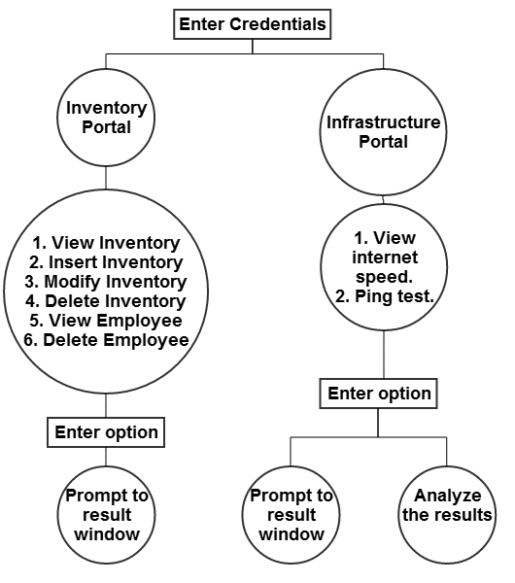
FUNCTIONAL REQUIREMENTS
Notes:
The System aims at providing an efficient interface to the user for managing of inventory and to keep warranty history of inventory, The design is such that the user does not have to manually Check the warranty or AMC period of the inventory every time.
The System calculates the warranty expiry time in every one week and send an alert message to the user before the warranty expires, and that are pre-set by the user(admin). Therefore the user never has to worry about manually calculating the warranty period.
The simple interface of the System has functions like adding contacts to your phonebook.

Slide 5
NON FUNCTIONAL REQUIREMENTS
The System must give accurate inventory status to the user continuously.
The System must successfully add any inventory given by the user (admin) and provide the inventory status
The system must provide a password enabled login to the user.
Notes:
The system should not update the data in any database for any failed processes.
RELIABILITY

Slide 6
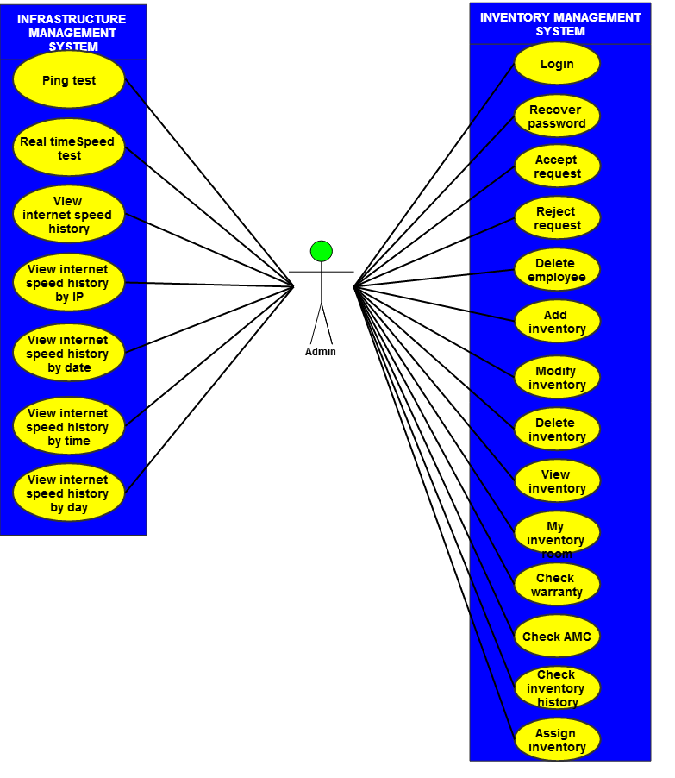
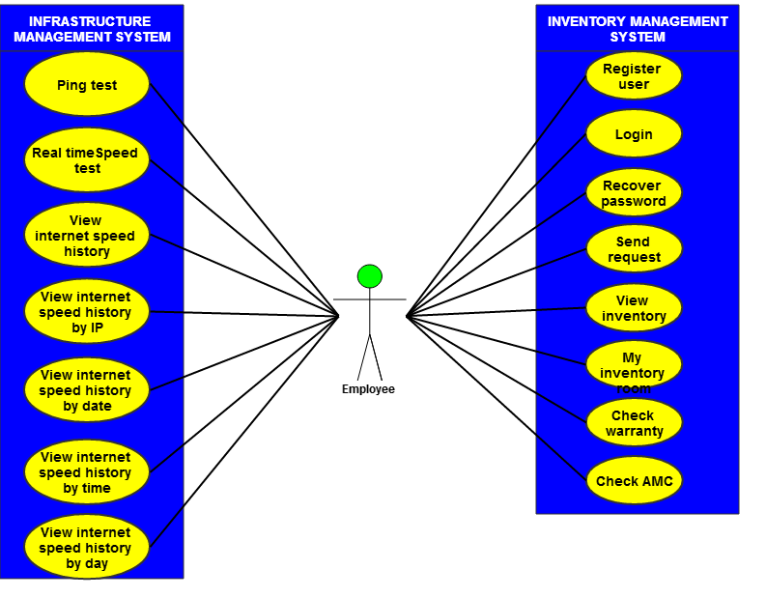
DESIGN PHASE-USE CASE DIAGRAM
fig: use case for admin
fig: use case for employee

Slide 7
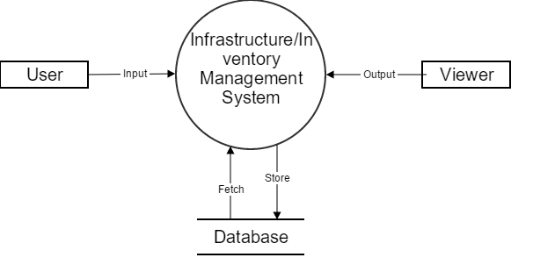
DFD
fig: Context diagram

Slide 8
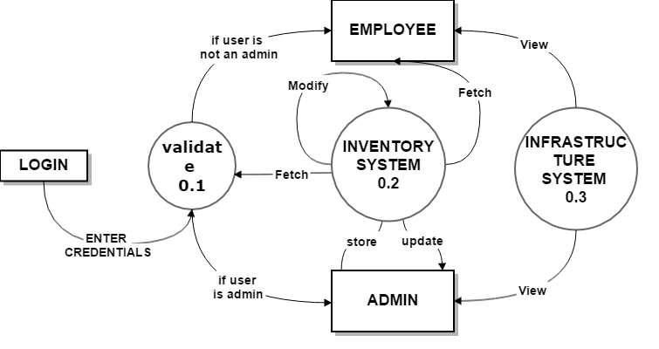
DFD continued…
fig: DFD level 1.1

Slide 9
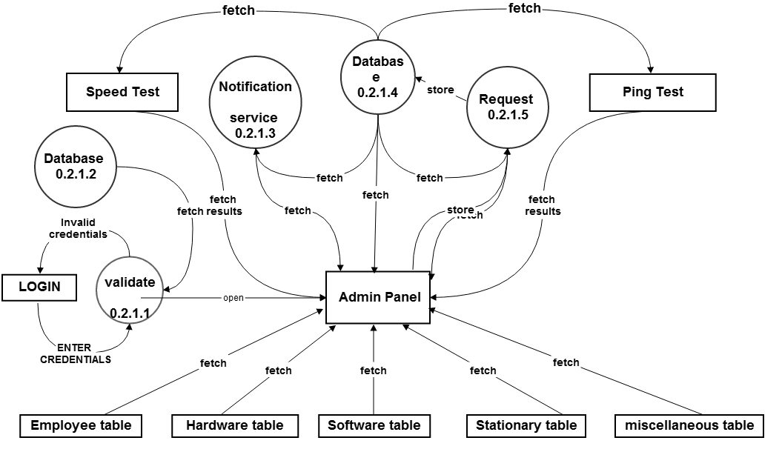
DFD continued…
fig: DFD level 2.1.1

Slide 10
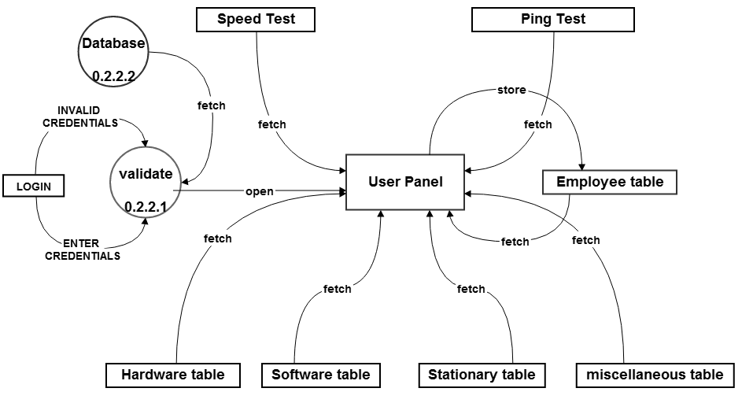
DFD continued…
fig: DFD level 2.1.2

Slide 11
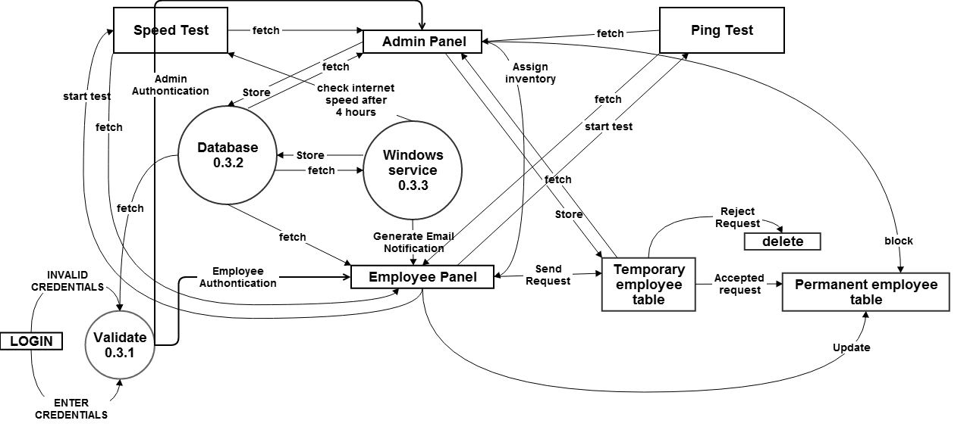
DFD continued…
fig: DFD level 3.1

Slide 12
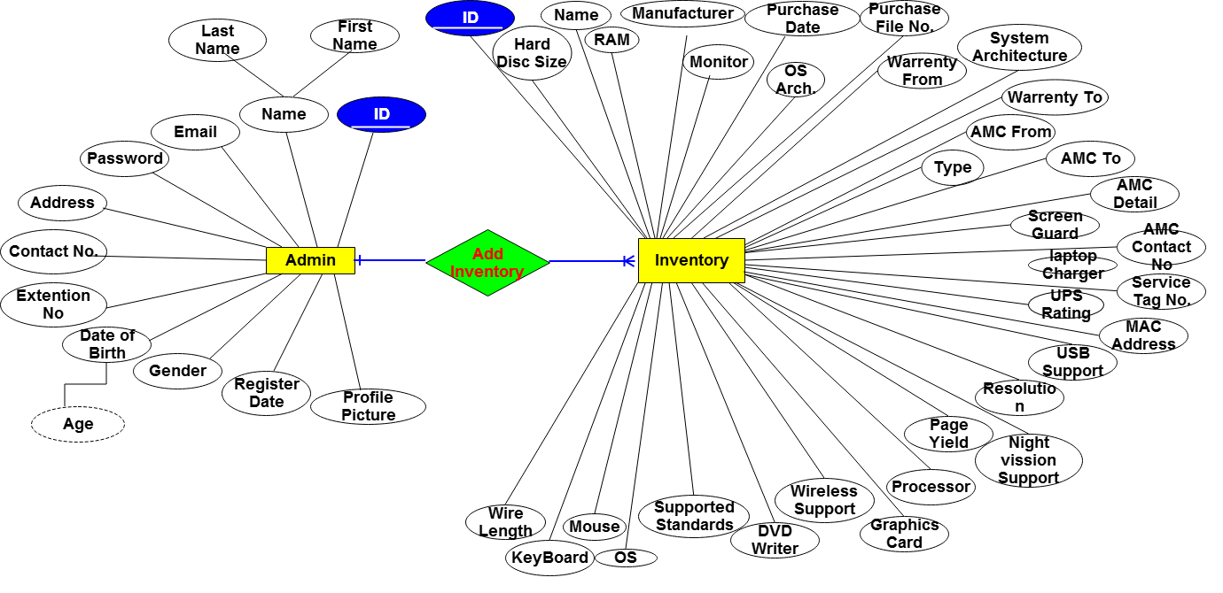
ER DIAGRAM 1
fig: ER (admin and inventory)

Slide 13
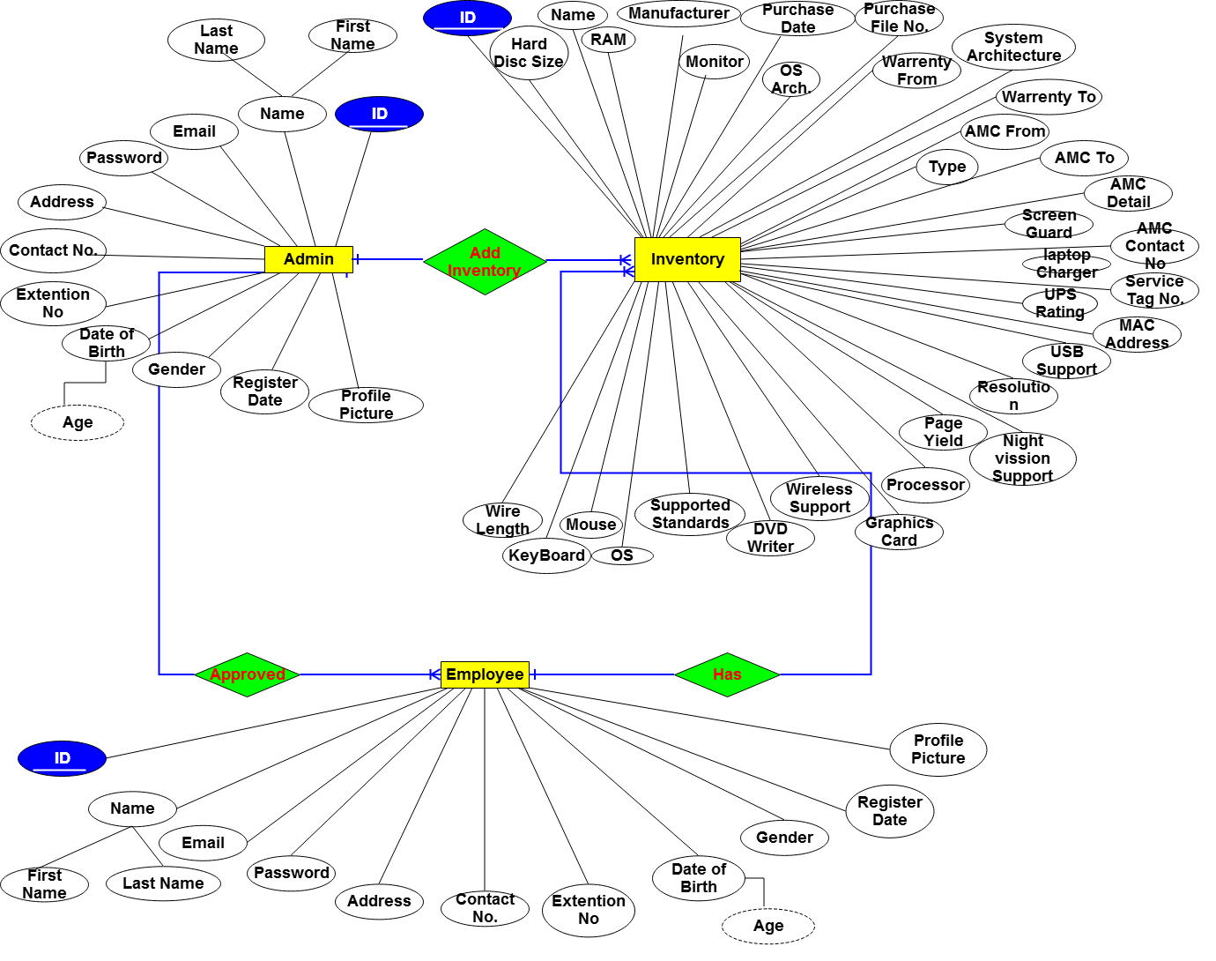
ER DIAGRAM 2
fig: ER diagram (admin, inventory & employee)

Slide 14
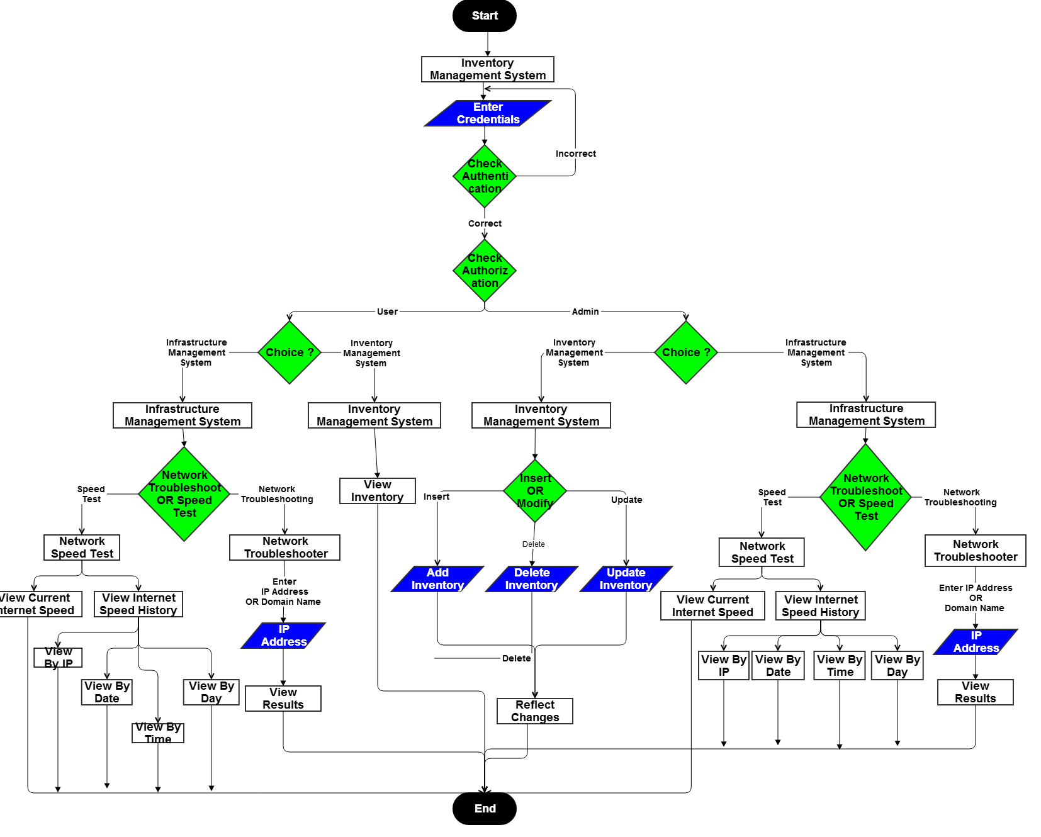
FLOW CHART
fig: ER (admin and inventory)

Slide 15
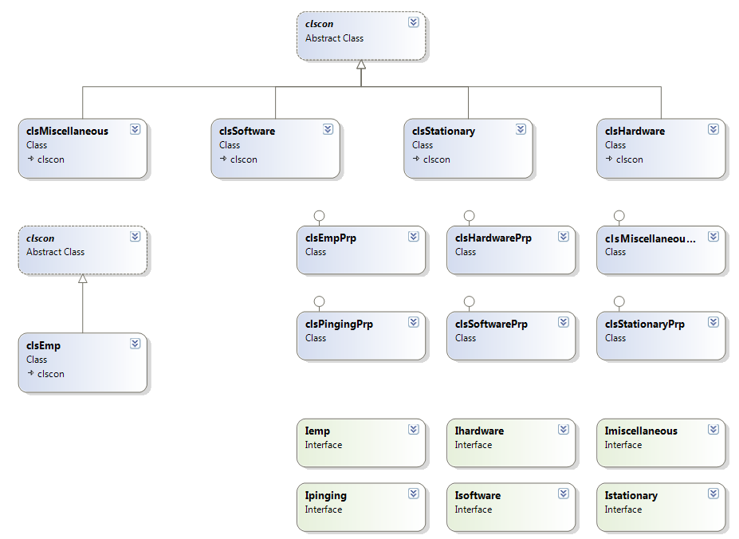
CLASS DIAGRAM 1
fig: class diagram of the project

Slide 16
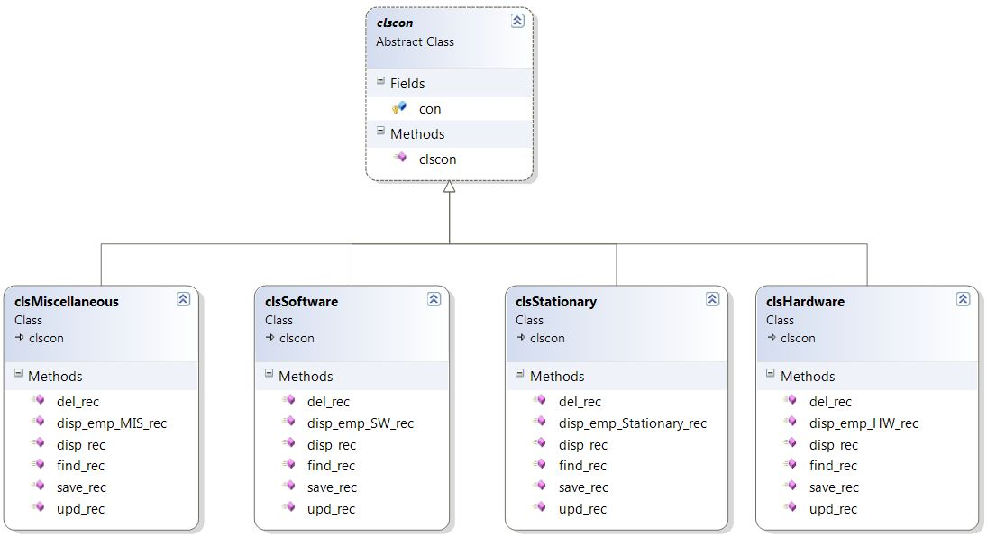
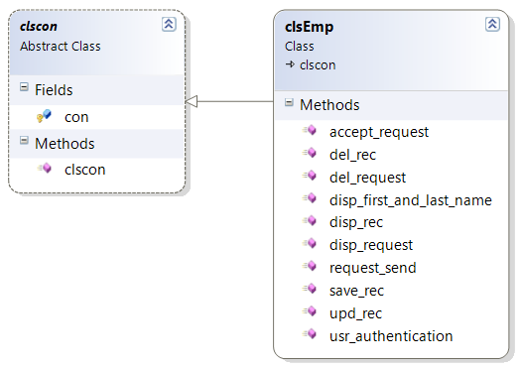
CLASS DIAGRAM 2
fig: class diagram for admin panel
fig: class diagram for employee panel

Slide 17
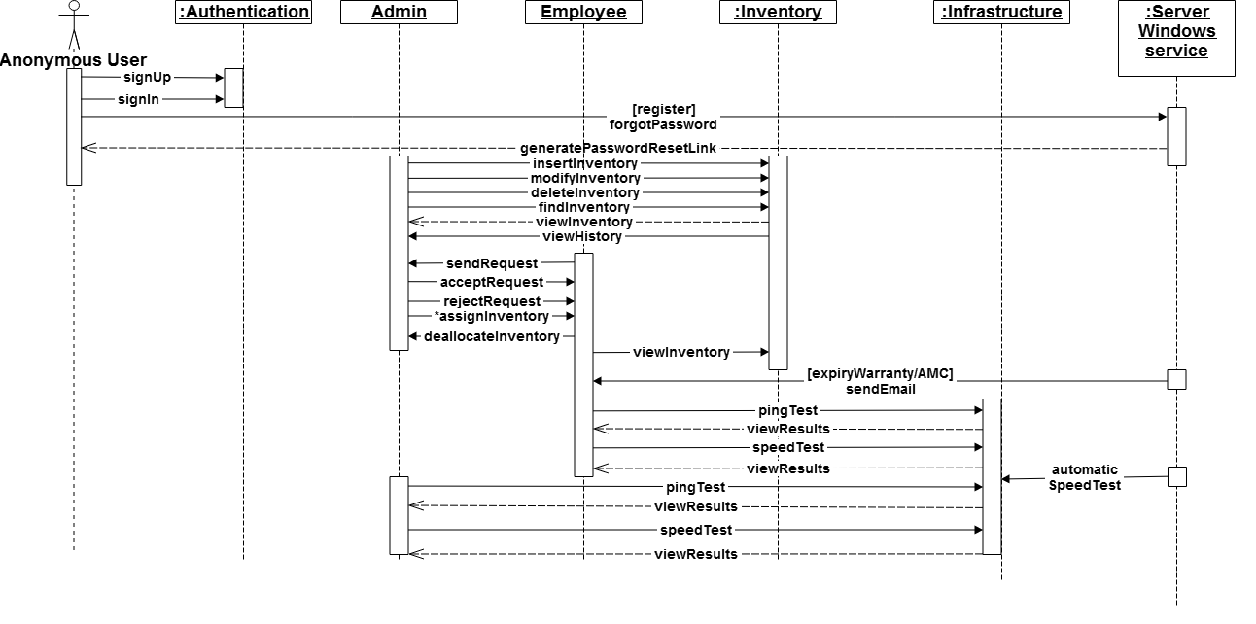
SEQUENCE DIAGRAM
fig:sequence diagram of the project

Slide 18
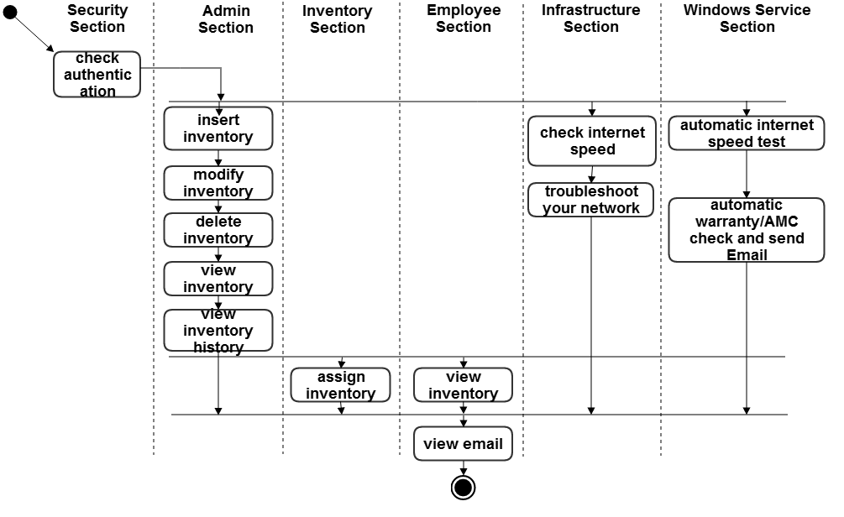
ACTIVITY DIAGRAM
fig:activity diagram of the project

Slide 19
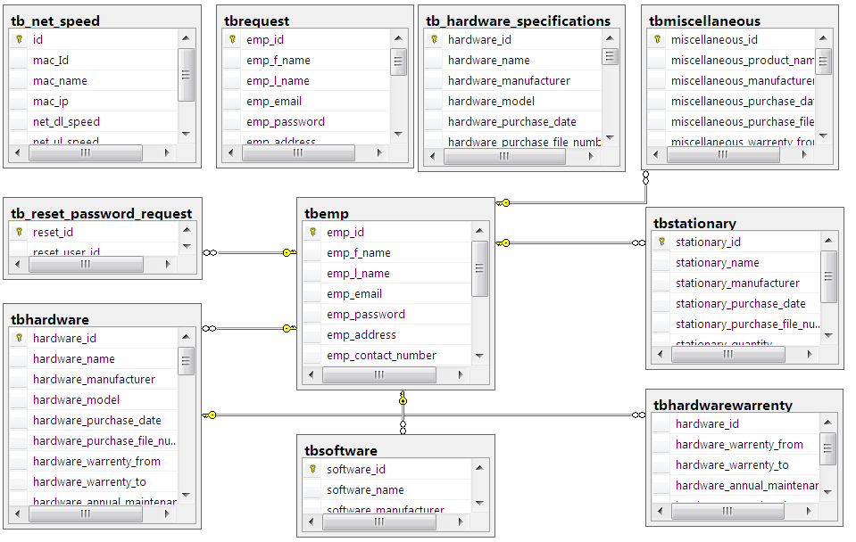
DATABASE/ BACKEND DIAGRAM
fig:database diagram

Slide 20
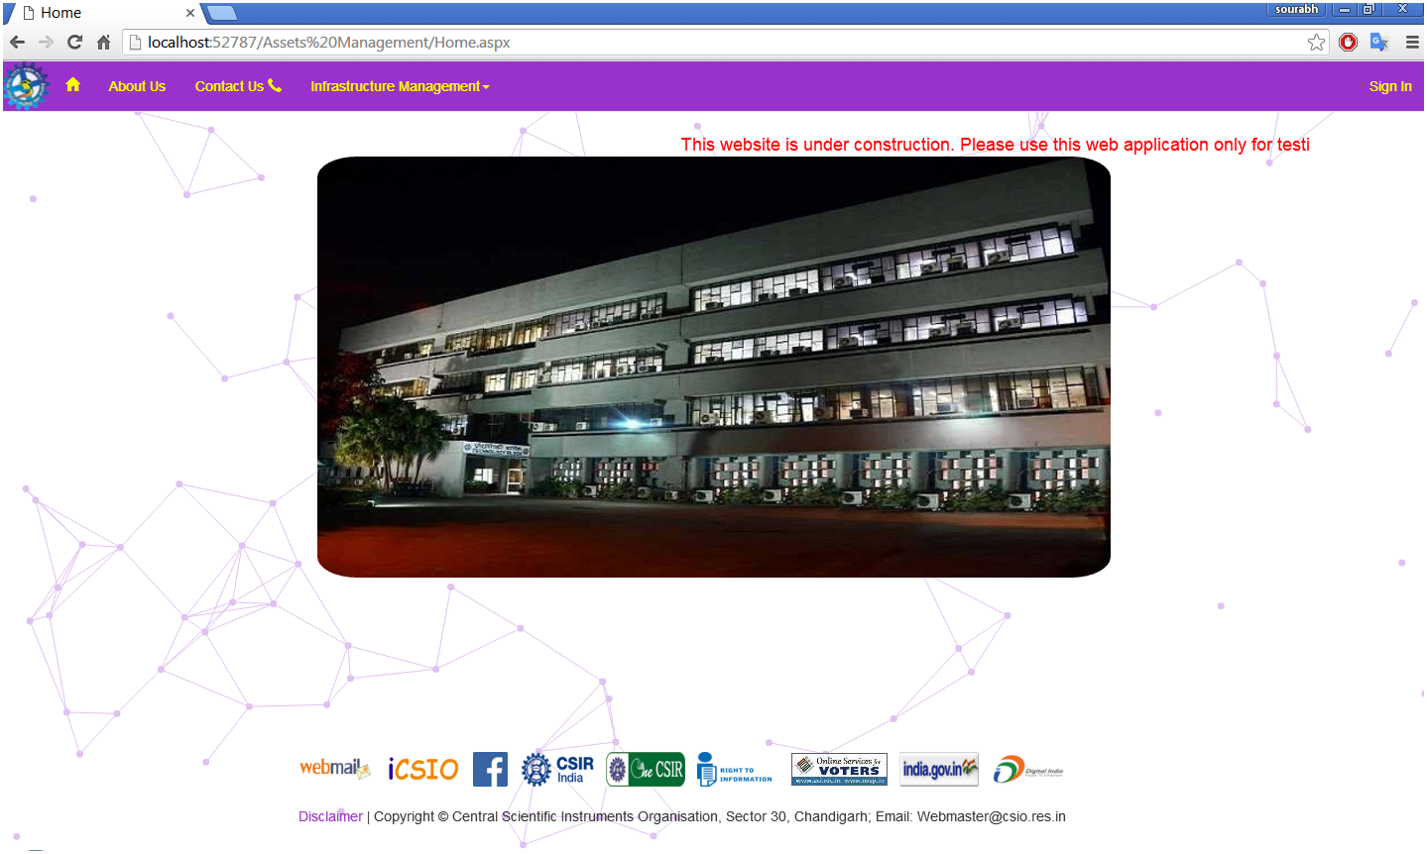
FRONT END
Step 1

Slide 21
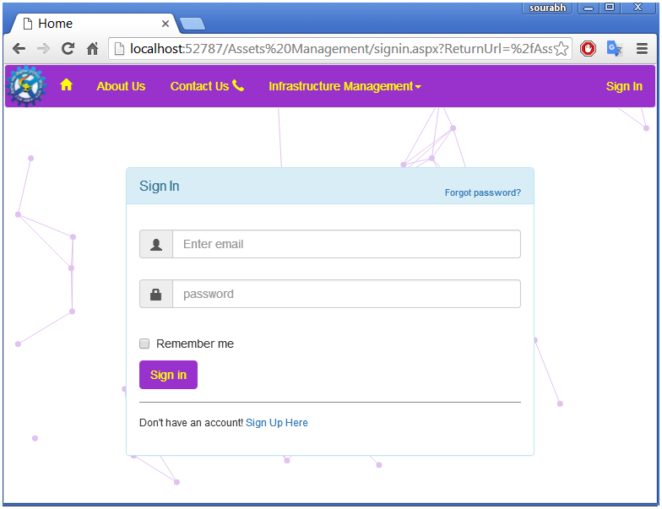
Step 2

Slide 22
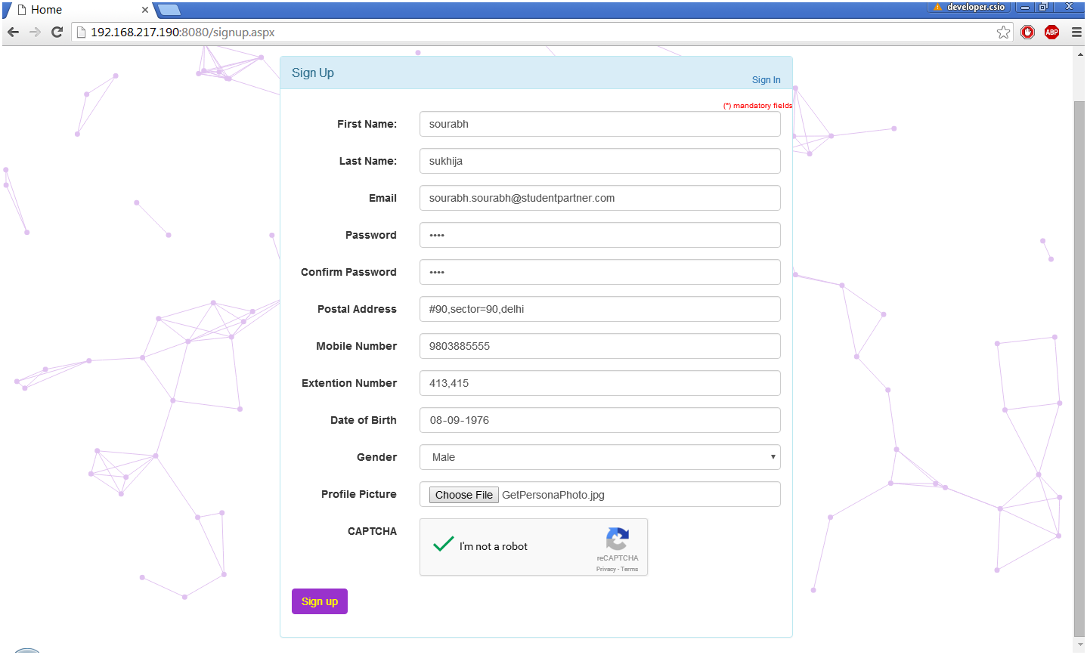
Step 4
Step 3

Slide 23
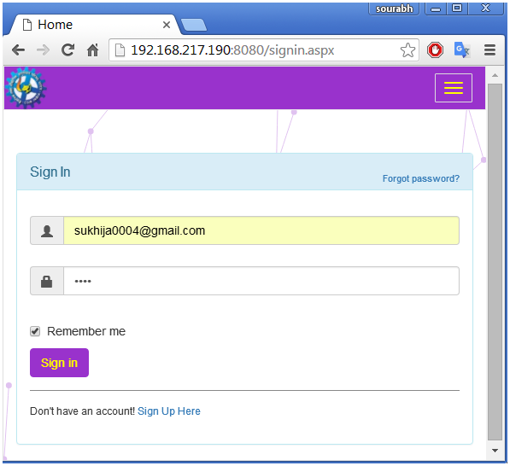
Step 5

Slide 24
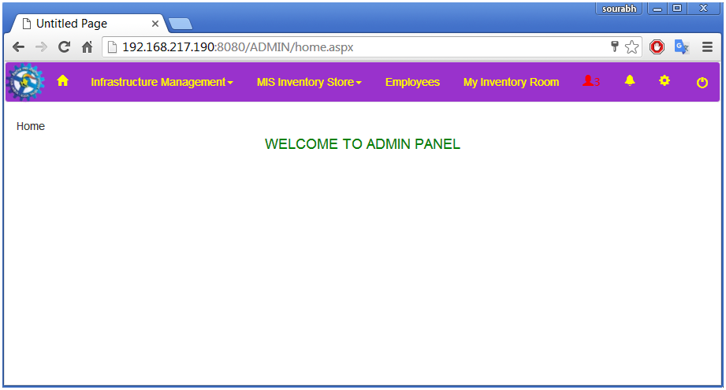
Step 6

Slide 25
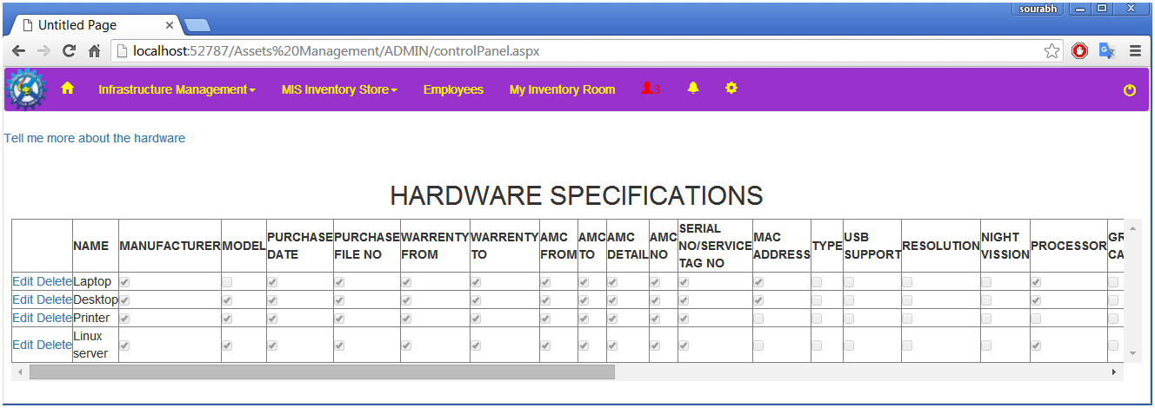
Step 7

Slide 26
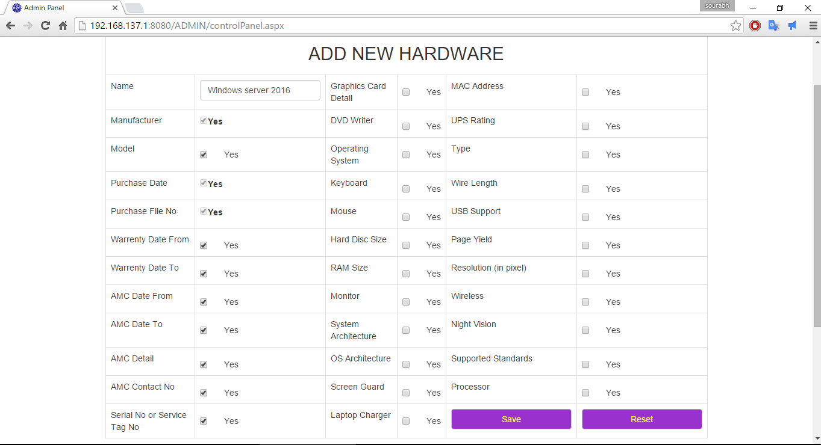
Step 8

Slide 27
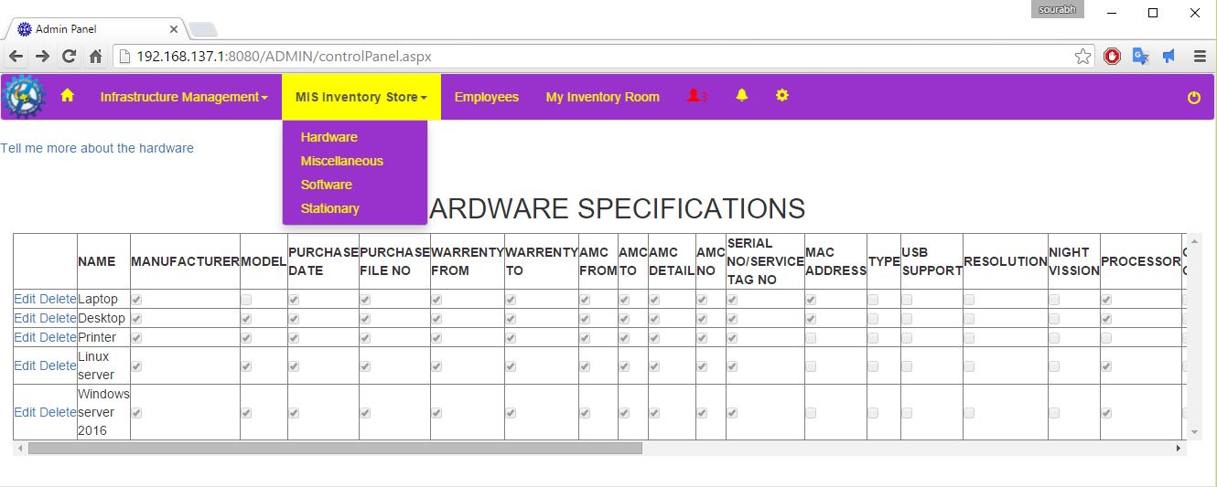
Step 9

Slide 28
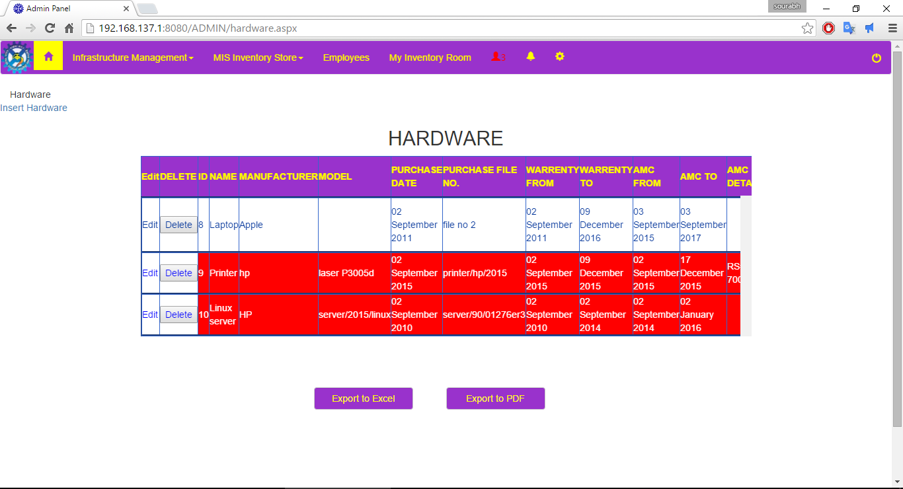
Step 10

Slide 29
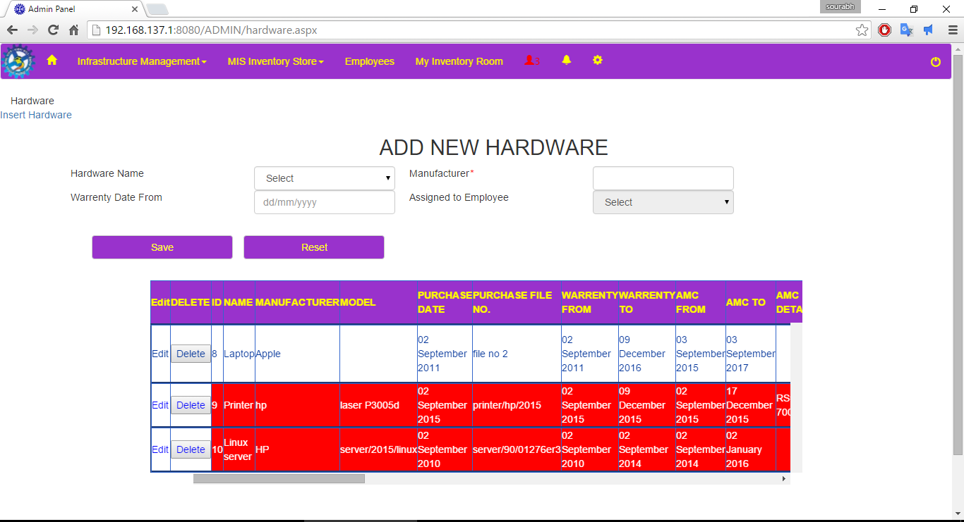
Step 11

Slide 30
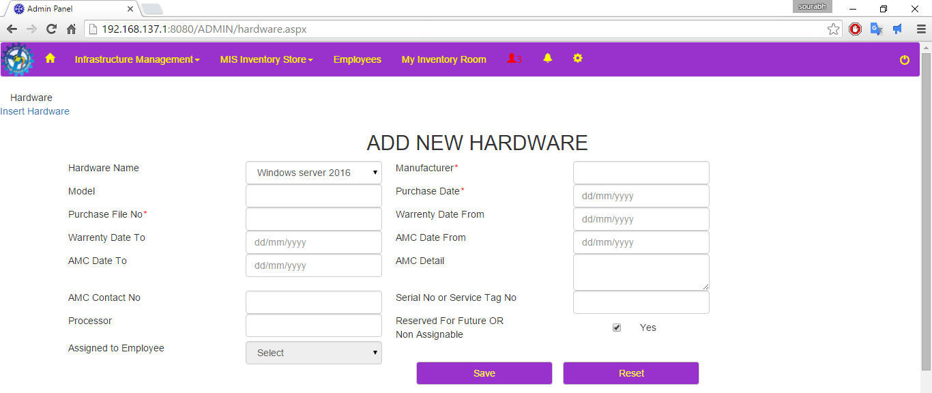

Slide 31
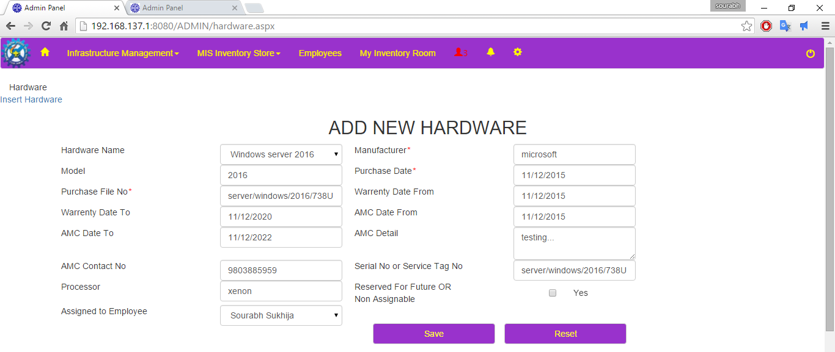
Step 12

Slide 32
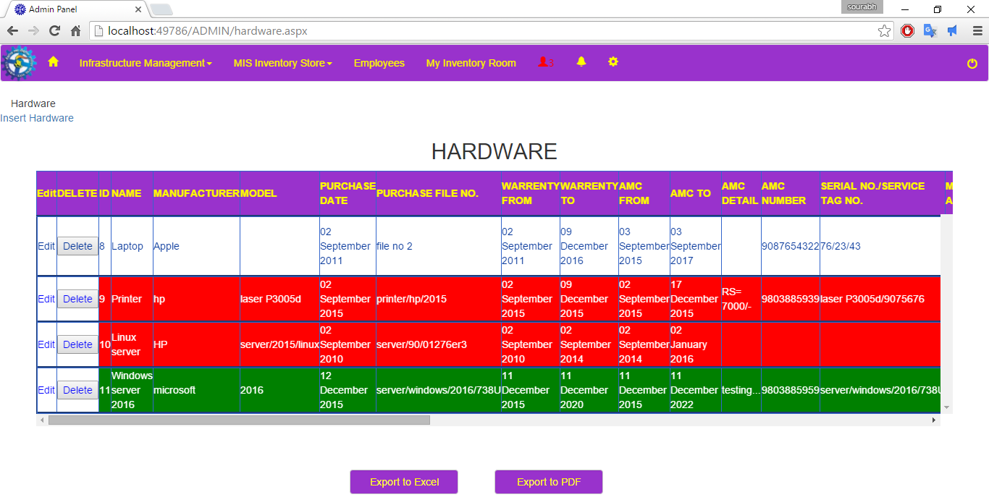
Step 13

Slide 33
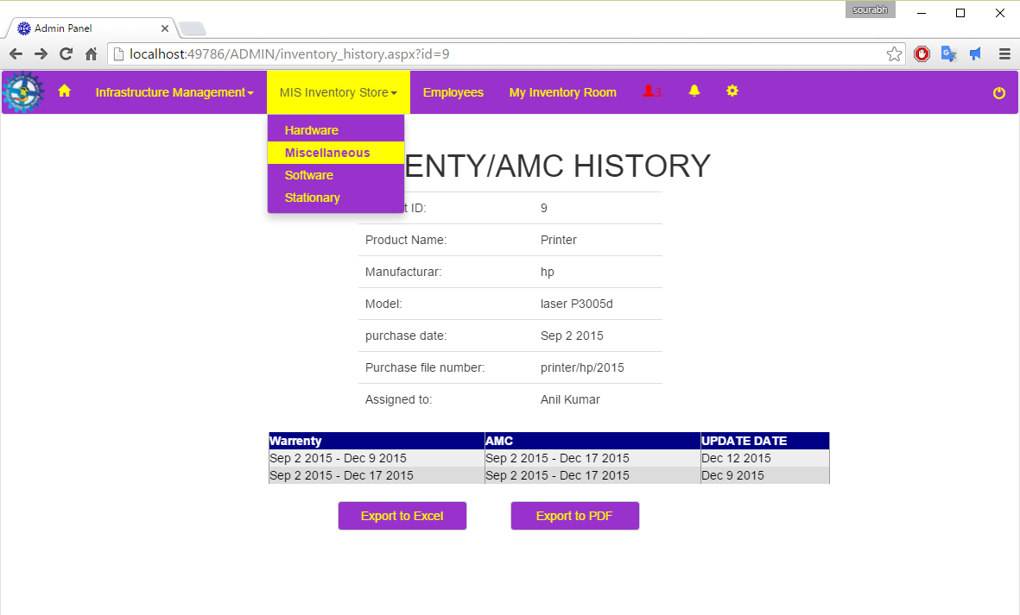
Step 14

Slide 34
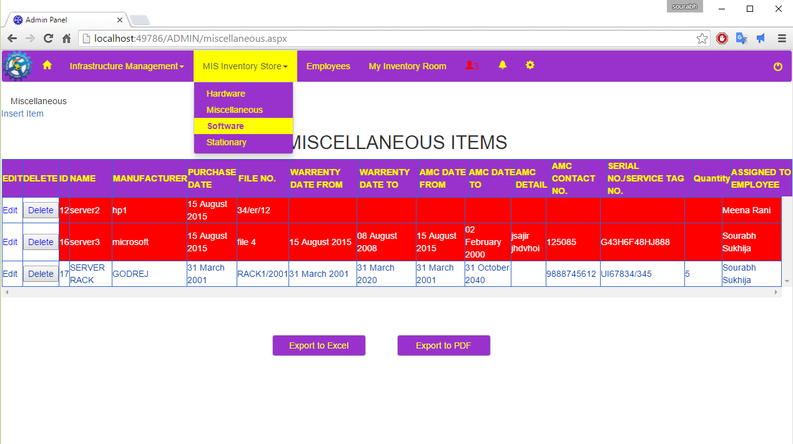
Step 15

Slide 35
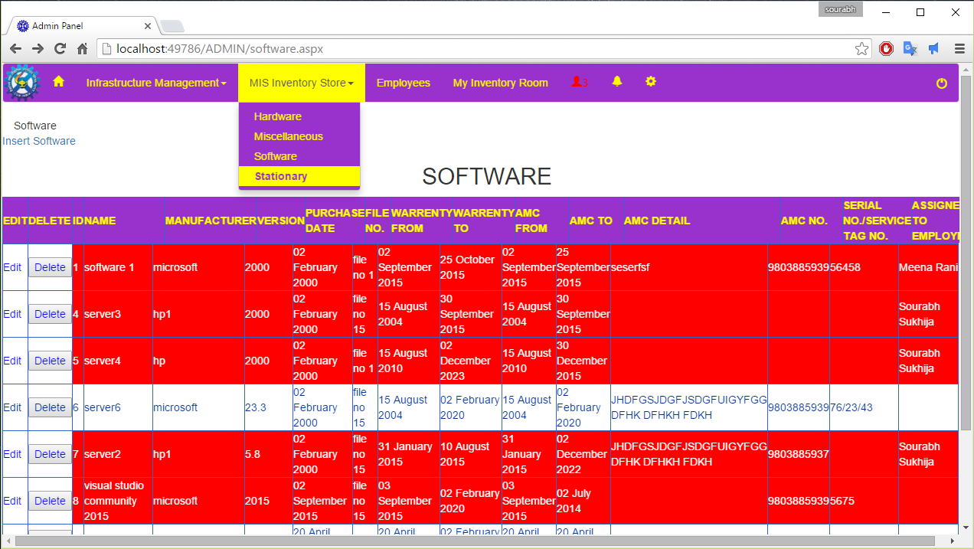
Step 16

Slide 36
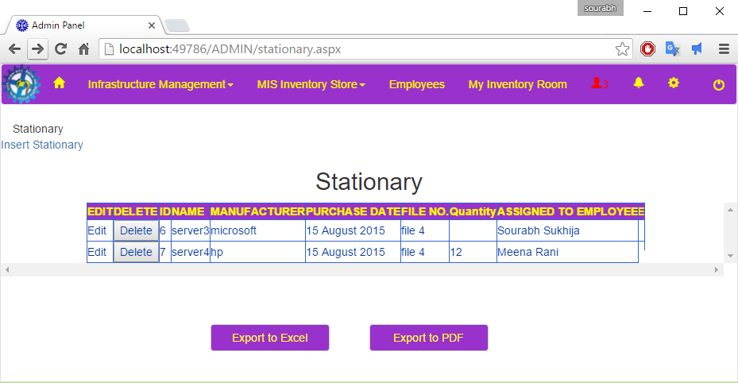
Step 17

Slide 37
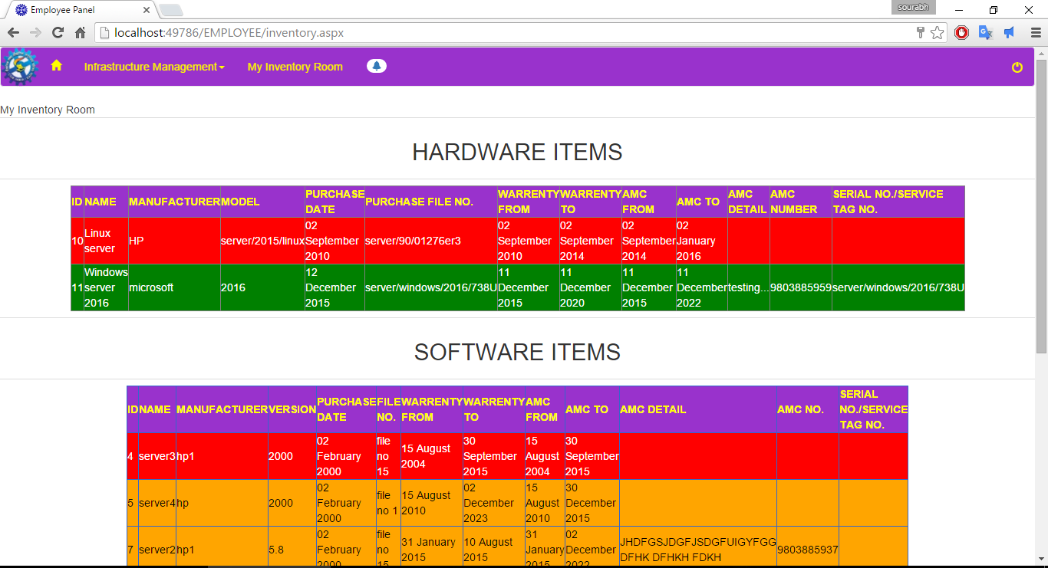
Step 18

Slide 38
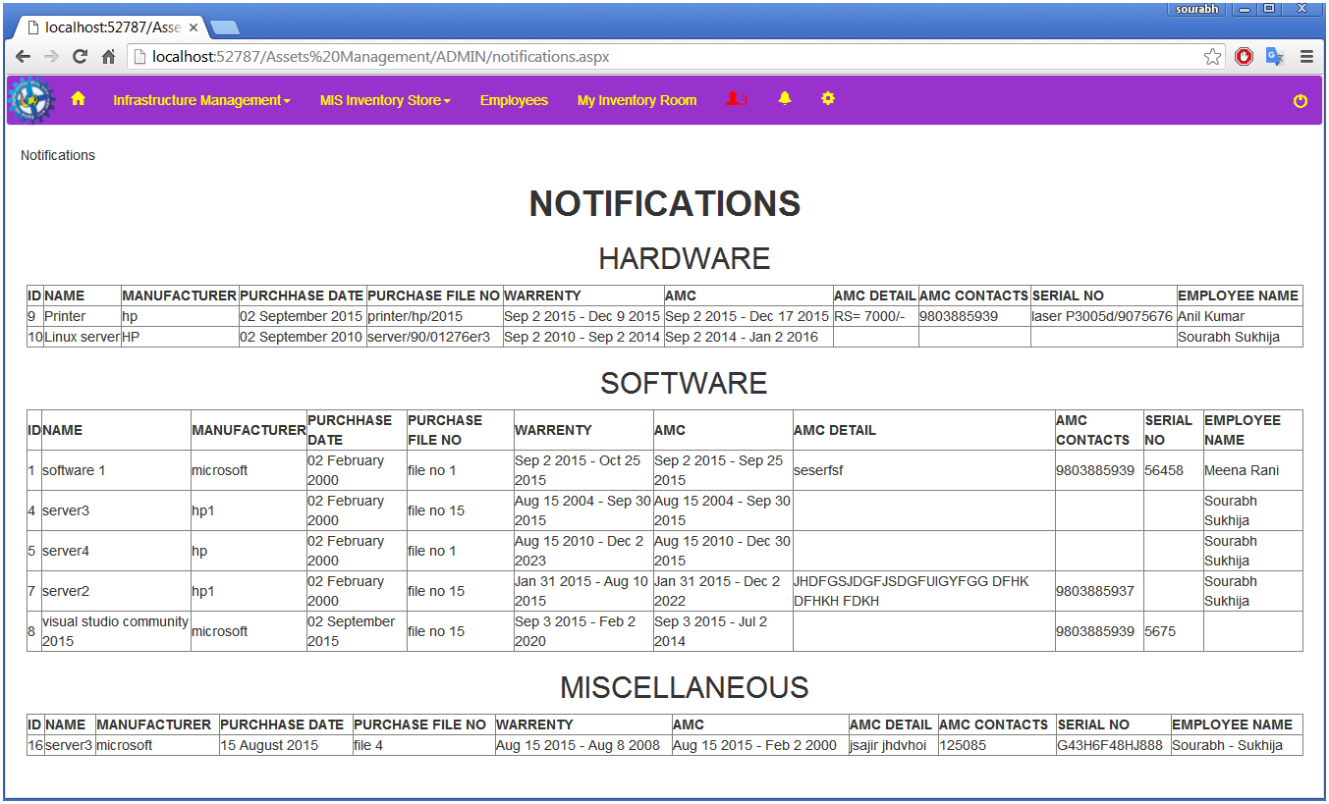
Step 19

Slide 39
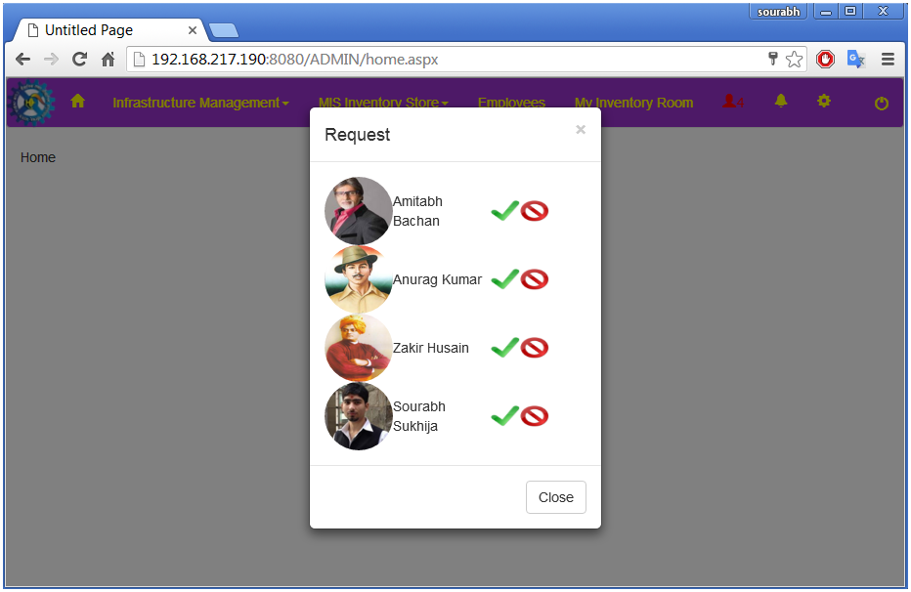
Step 20

Slide 40
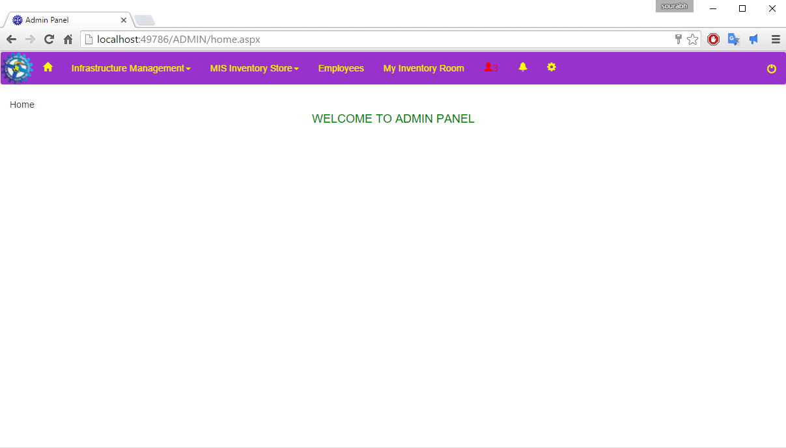
Step 21

Slide 41
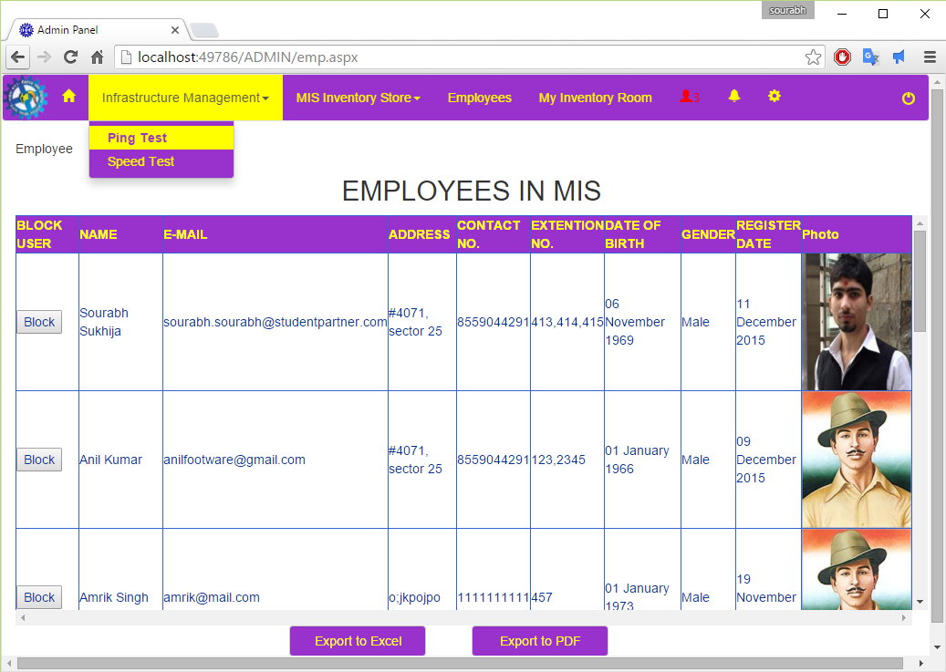
Step 22

Slide 42
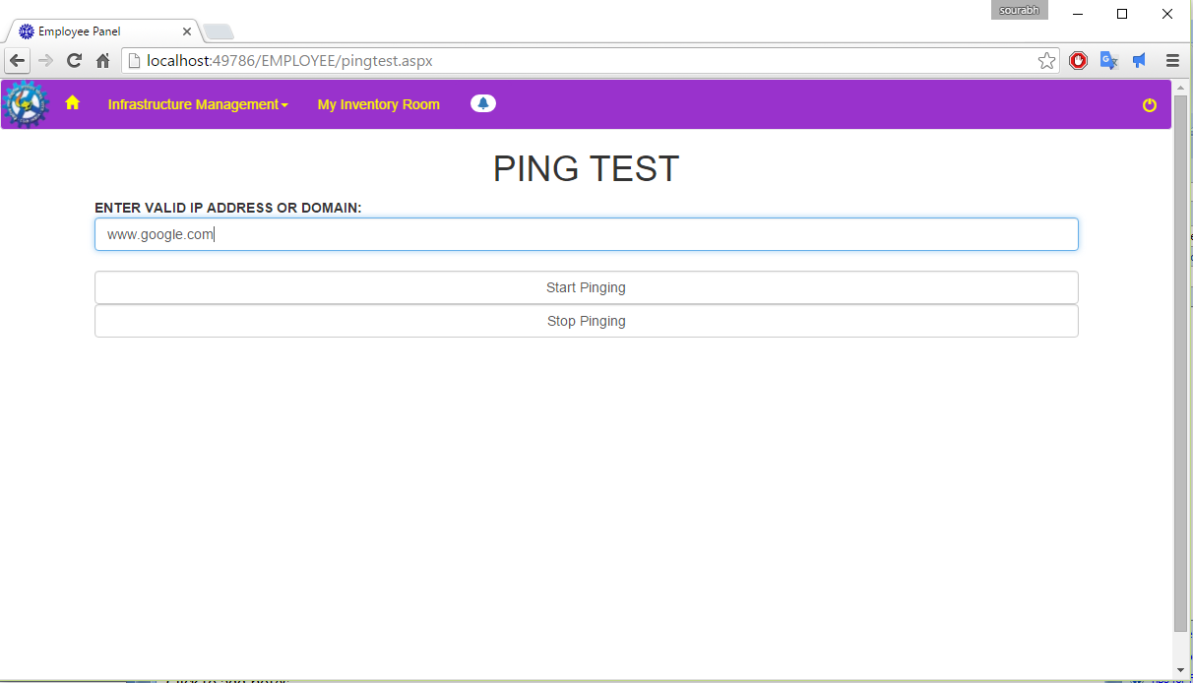
Step 23

Slide 43
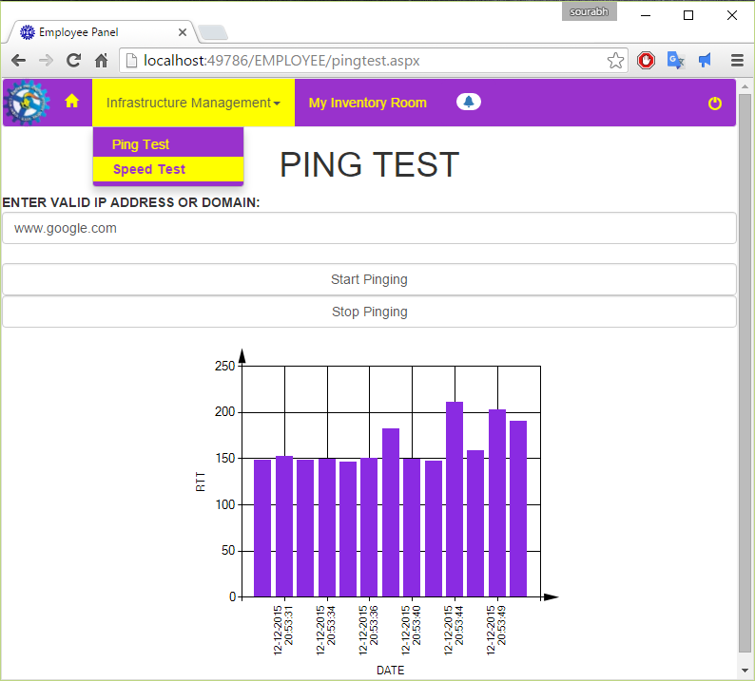
Step 24

Slide 44
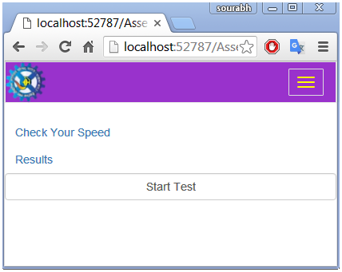
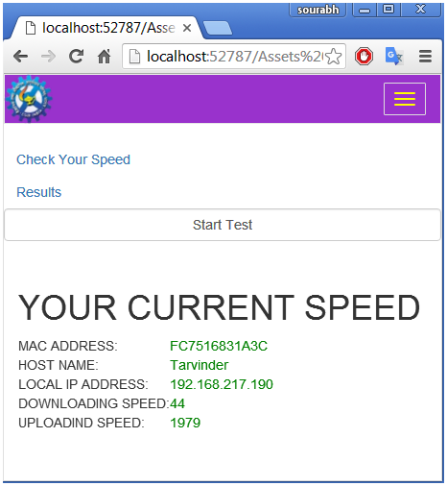
Step 25
Step 26

Slide 45
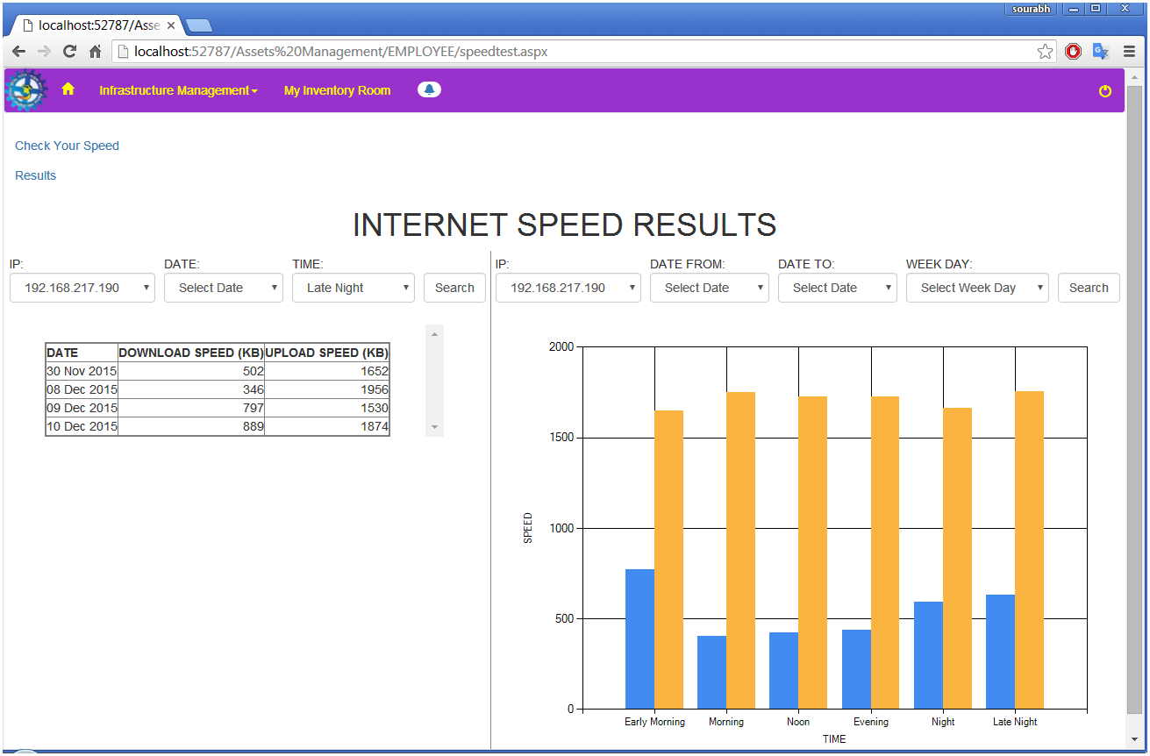
Step 27
Step 28
LOG OUT

Slide 46
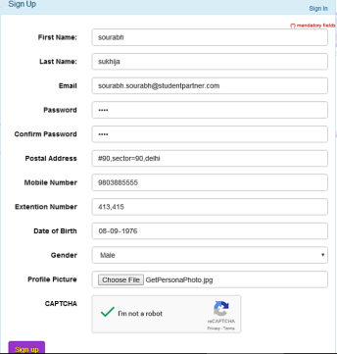
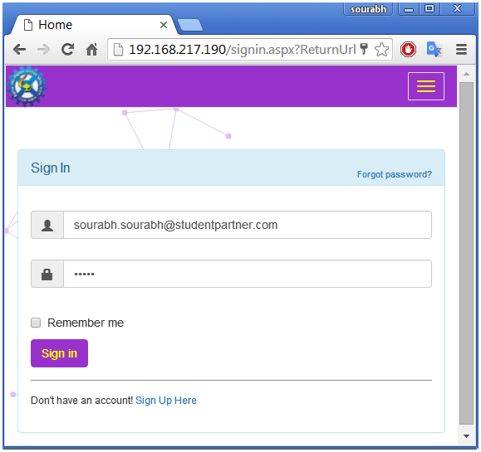
EMPLOYEE PANEL
Step 1

Slide 47
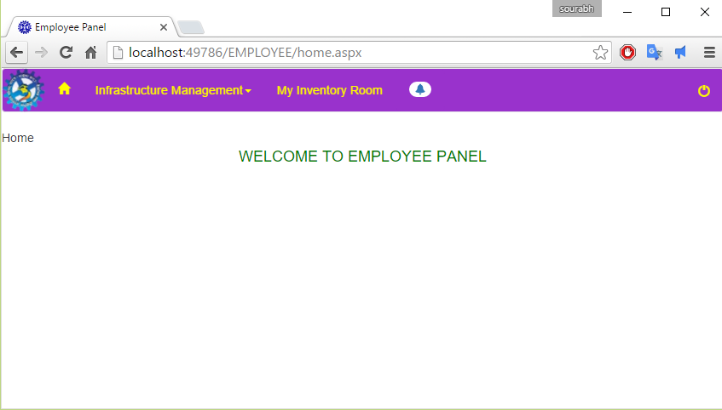
Step 2

Slide 48
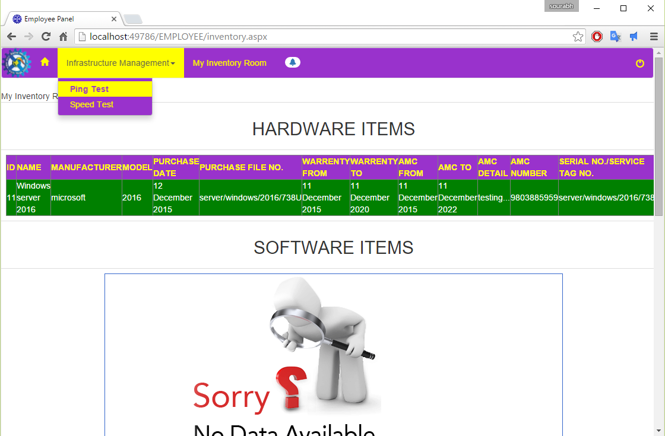
Step 3

Slide 49
Step 4

Slide 50
Step 5

Slide 51
Step 7
Step 6

Slide 52
Step 8
Step 9
LOGOUT

Slide 53
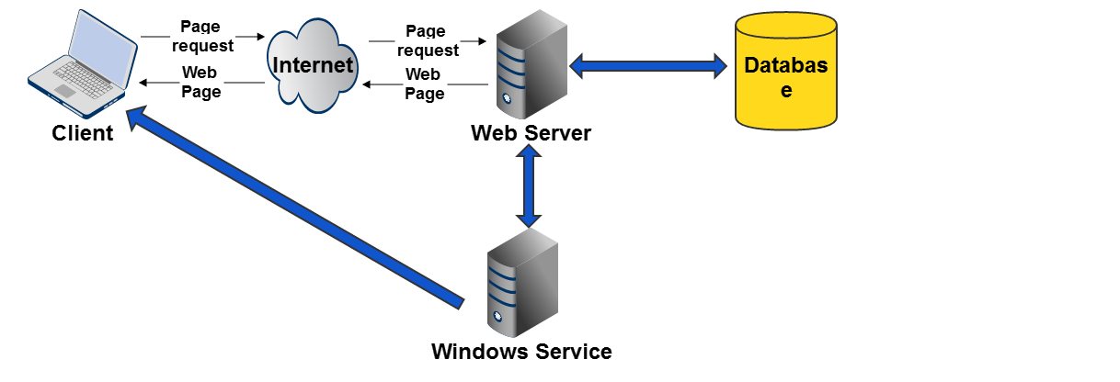
ARCHITECTURE
fig: Architecture of the project

Slide 54
Thank you
Queries……?

